Slide 1


Slide 2

30 Days Data Scinece & Analytics Master Class
Day1 : Python for Data Science
Time: 6.00 PM IST
Free Registration

Slide 3
30 Days Data Scinece & Analytics Master Class
Handbook

Slide 4

What is Master Class ?
👍 This is the 30 Days Industrial Learning Activity.
👍 Its Online YouTube Live Class
👍 If you Invest 45 minutes daily, U will become Master in Data Science
👍 You will get FREE E-Certificate
Webinar Participation Certificate
“Learning is the beginning of wealth.
Searching & Learning is where the miracle process all begins.” …………….Jim Rohn

Slide 5
Pantech?
Educational Equipment Manufacturer
IoT, AI, Robotics,Autonomous Robot
Microprocessor/Microcontroller
DSP,VLSI, Embedded System
Power Electronics & Drives, Fuel Cell Trainer Kit
Renewable Energy Lab, Electric Vehicle Lab
Technical Training
DIY Project

Slide 6
Our Vision
Help 10 Million Students to Learn the Technology in Easy Way

Slide 7

Associate Partner for this Master Class
https://apssdc.in/home/

Slide 8
NANDHINI.S
Exp: 5 Yrs
Expert in
Python Developer on Machine Learning
Deep learning with computer vision
Matlab – Image Processing
Autonomous Car design using ROS with LIDAR
Language – Python , Java , HTML ,CSS.
Tools – ANACONDA NAVIGATOR, JUPYTER NOTEBOOK,
GOOGLE COLAB.
Graduation : BE – ECE | 2011

Slide 9
What U will Learn from 30 Days Data Science & Analytics Master Class

Slide 10
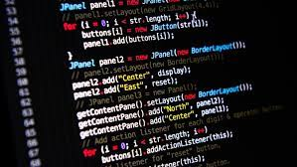
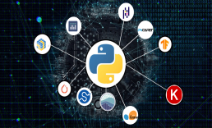

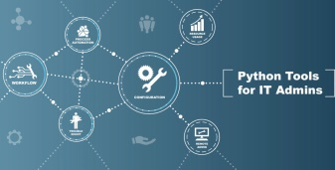
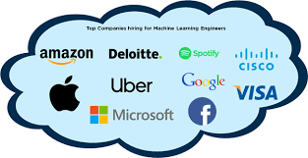
Data Science & Analytics Learning Plan
01
02
03
04
05
Library
Python
Analytics
Tools
Industry Project
Introduction To Python and Python Data Structures
Pandas
Numpy
MatplotLib
Cborn, SKLearn Lib
Collab
Distribution
Visualization
Aggregation
Statistics
PowerBi
Tableo
Project Building,
DSA Jobs

Slide 11
Day wise Learning Plan
Day -1 : Python for Data Science (5 Solved end-to-end Data Science Projects in Python)
Day -2: Advanced Python Programming
Day -3: Pandas Library – Introduction
Day -4: Pandas Library – Data Structures
Day -5: Numpy library – Array Operations | Mathematical Functions
Day -6: Numpy – Sort, Search and Counting Functions
Day -7: Matplotlib , Histogram Using Matplotlib | I/O With Numpy
Day -8: Matplotlib Library – Introduction , Pyplot API | Types Of Plots
Day -9: Seaborn Library
Day -10: SKLearn Library
Day -11: Google Colab Notebook
Day -12: Python – Date and Time, Data Wrangling
Day -13: Python – Data Aggregation
Day -14: Python – Word Tokenization , Stemming and Lammetization
Day -15: Python – Data Visualization

Slide 12
Day wise Learning Plan
Day -16: Python – Statistical Analysis
Day -17: Python – Types Of Distribution
Day -18: Python – Correlation ,Chi-Square Test , Linear Regression
Day -19: Tableau – Introduction and Tools
Day -20: Tableau – Data Sources , Worksheets
Day -21: Spatial Data Science For Covid-19 Disease Prediction
Day -22: Power-BI – Introduction, Installation Steps and Architecture
Day -23: Power-BI – Data Modelling , Visualization Options | Excel Integration
Day -24: Parkinson’s Disease Prediction – XG Boost Classifier
Day -25: House Price Prediction using Random Forest Regression
Day -26: Customer Segmentation Using ML – K-Means Clustering
Day -27: Home Loan Prediction using Decision Tree Classifier
Day -28: Spam Classification using NLP
Day -29: Hand Written Digit Recognition Using CNN
Day -30: Churn Prediction using Deep Learning

Slide 13
List of Projects for Demo in YouTube Live
Spatial Data Science For Covid-19 Disease Prediction
Parkinson’s Disease Prediction-XGBoost Classifier
House Price Prediction-Random Forest Regression
Customer Segmentation Using ML-K-Means Clustering
Home Loan Prediction-Decision Tree Classifier
Spam Classification-NLP
Hand Written Digit Recognition Using Python-CNN
Churn Prediction-Deep Learning
Crop Yield Prediction
Ground water level prediction
All Projects in Jupyter Notebook

Slide 14
What you will get from this Free 30 Days Master Class?
You can attend YouTube Live Class
Free E-Certificate ( WEBINAR PARTICIPATION CERTIFICATE)

Slide 15
How to mark your Attendance in YouTube Live Class?
Ans : During the Live Class, organizer will post Google Form link in Live Chat. The Participants should submit the from on daily basis. Minimum 25 Days Attendance is Required to get Free Master Class Participation Certificate.
Note : The Link will be available during the Live. From the LIVE Class date, the live video will get removed from the YouTube in 3 days.

Slide 16
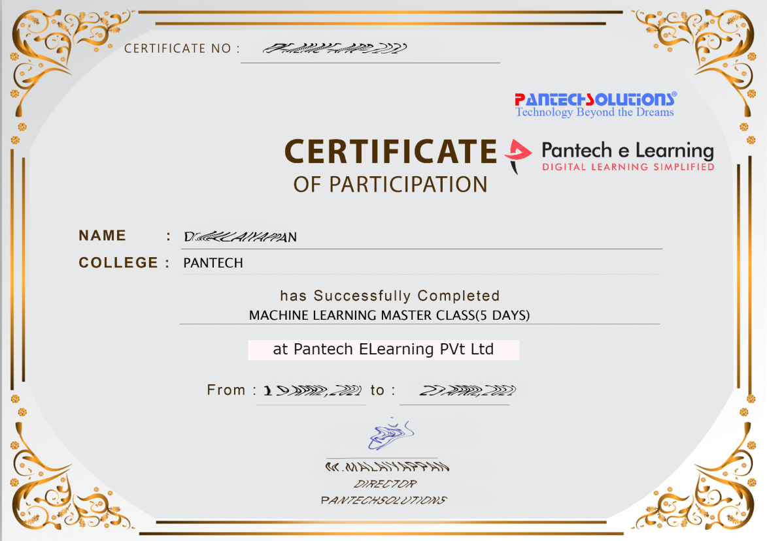

Sample Webinar Participation Certificate?

Slide 17
https://www.pantechelearning.com/data-science-master-class/
On Demand
You can get chance to apply 1 Month Internship on Data Science & Analytics Master Class

Slide 18
What is Internship????
Learn
Practice
Verify
Get Certified
Grow

Slide 19
Free Master Class DSA | 1 Month Internship on DSA
Master Class Participation Certificate | Internship Completion Certificate
Minimum 25 Class should attend YouTube Live | Recorded Class Link will be provided. – LMS Portal Access
YouTube Live Mandatory | Your Choice. You can attend Live or else You can watch Recorded Class in LMS Portal
All Projects Demo class in YouTube Live | Step by Step Video Explanation Content in LMS Portal
Access : 3 Days | VIP WhatsApp Group Support
 | You Can Download All PPTs
 | 4 Nos of Hackathon Class in Zoom Live. The Recording also will be provided
 | You Can Download All Project Files
 | Mentor will guide you to finish 10 Projects
 | Access : 60 Days

Slide 20
Pantech will make you to Create 10 Projects in Data Science & Analytics in 30 Days
Objective of this 30 Days Master Class

Slide 21
1 Month Internship in Data Science
INTERNSHIP E-Certificate(30Days Internship on Data Science Engineering)
Highly organized Video content
Download All Files
Download PPTs
Assignments
Flexible Time.
Access Period: 60Days from the date of payment

Slide 22
What You Will Get???
Complete Project Files
30 Days Learning Activity
Data Science Core Concepts
10 + Projects
Project PPT
Spatial Data Science For Covid-19 Disease Prediction
Parkinson’s Disease Prediction-XGBoost Classifier
House Price Prediction-Random Forest Regression
Customer Segmentation Using ML-K-Means Clustering
Home Loan Prediction-Decision Tree Classifier
Spam Classification-NLP
Hand Written Digit Recognition Using Python-CNN
Churn Prediction-Deep Learning
Crop Yield Prediction
Ground water level prediction
Video Class Access for 2 Months
Get chance to Enroll 1-Month Internship on demand

Slide 23

How to join in 1 month Internship
https://www.pantechelearning.com/data-science-master-class/
Click Here
Coupon Code: WELCOMEDSE

Slide 24
DATA SCIENCE

Slide 25
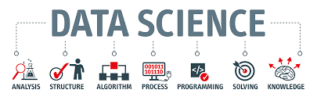

Slide 26
What is Data Science?
Data science is an interdisciplinary field that uses scientific methods, processes, algorithms and systems to extract knowledge and insights from data, and apply knowledge from data across a broad range of application domains.

Slide 27
Python

Slide 28
Introduction
Python is :
High-level programming language.
Fast to learn and fast to develop application.
Available for many platforms.
Implement complex logic with very few lines of code.

Slide 29
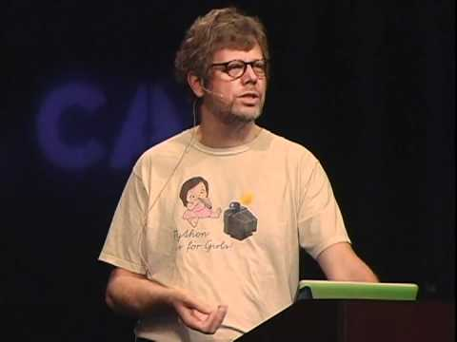
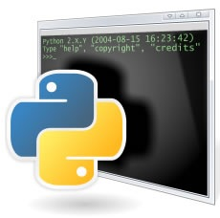

History
Guido van Rossum
At National Research Institute for Mathematics and Computer Science in Netherland.

Slide 30
Why One Should use PYTHON ?
What can I do in PYTHON

Slide 31
WHY ?

Slide 32
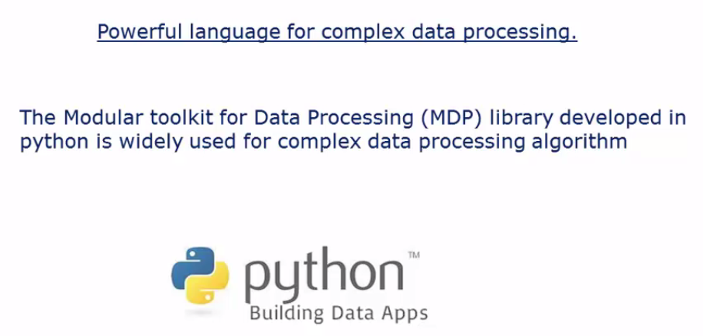
Data Processing

Slide 33
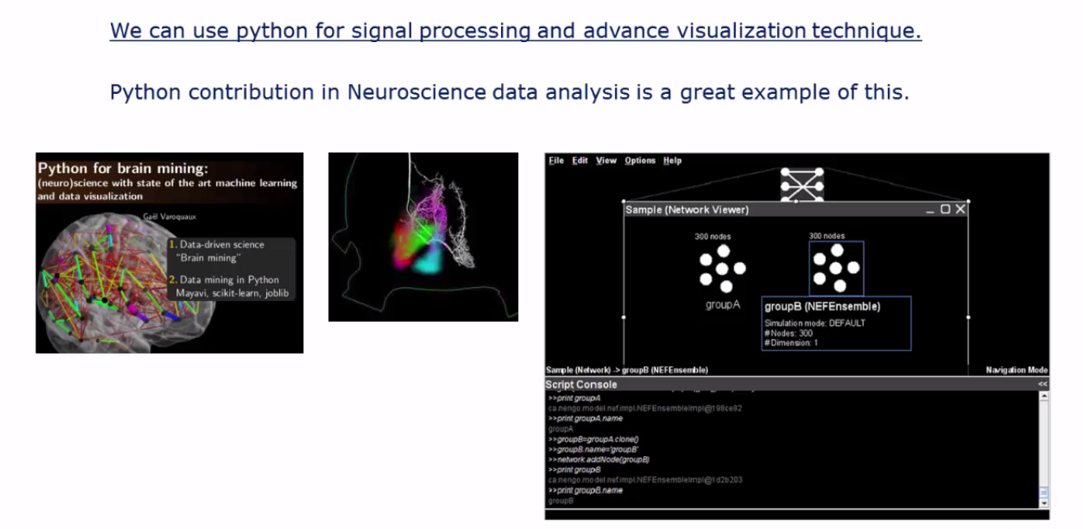
Signal Processing

Slide 34
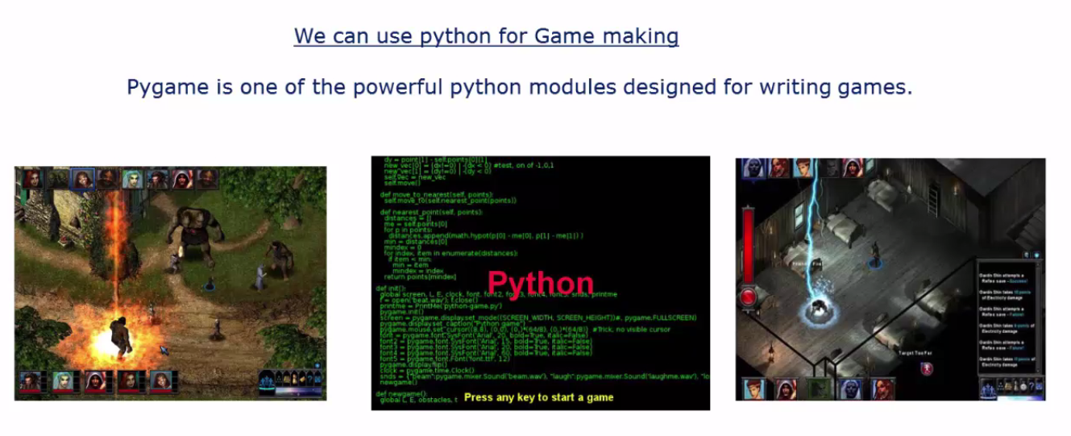
Pygame

Slide 35
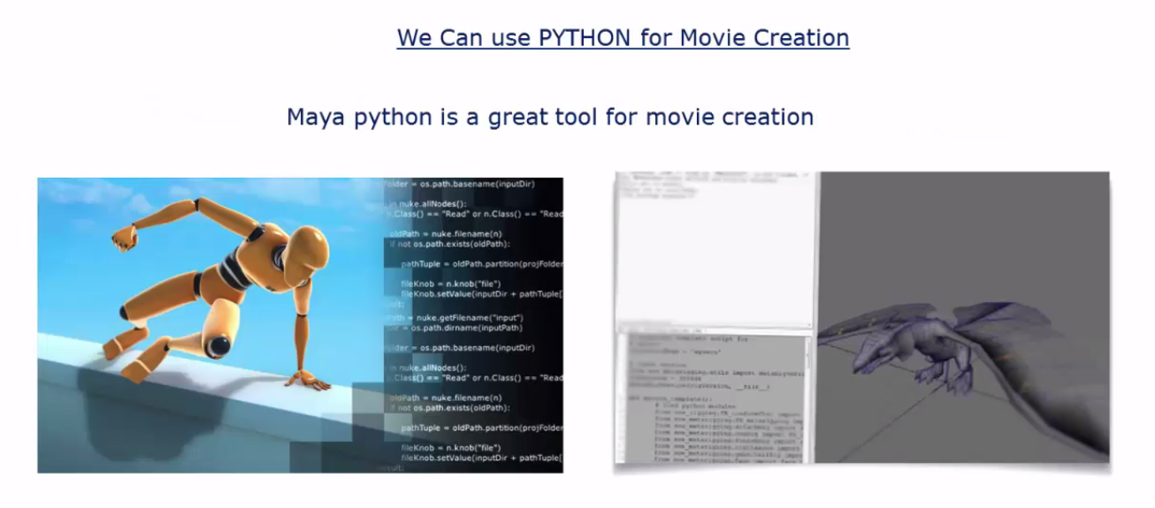
Maya Python

Slide 36
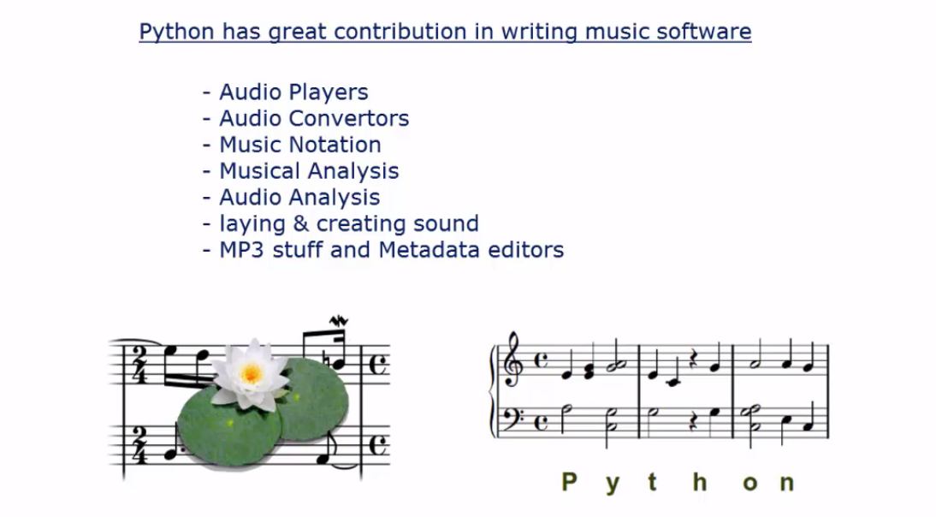
Music Software

Slide 37
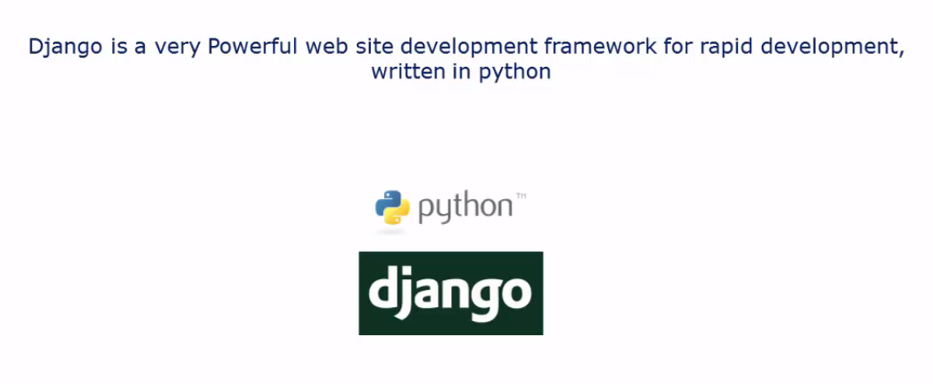
Web site development frame work

Slide 38
PYTHON 2 VS. PYTHON 3
Python 2 is legacy, Python 3 is the present and future.
Python 3 was released in 2008.
Python 3 don’t have enough libraries.
That’s why python 2 is present and still ON.

Slide 39
Python – Interactive Mode Programming:
Type the following text at the Python Prompt:
print ("Hello, Python!”)
If we run this code , we will get the following code:
Hello , Python!

Slide 40
Python – Identifiers
A python identifier is a name used to identify a variable , function , class , module or any object.
An identifier starts with a letter A to Z or a to z or an underscore followed by zero or more letters, underscores and digits(0-9).
Python does not allow punctuation characters like @, $, and % within identifiers.
It is a case sensitive programming language.

Slide 41
Python – Identifiers
Following are some of the naming conventions for Python identifiers:
Class names start with an uppercase letter.
All other identifiers start with a lowercase letter.
If an identifier starts with a single leading underscore , it indicates that the identifier is private.
If an identifier starts with two leading underscores , it indicates a strongly private identifier.
If the identifier ends with two trailing underscores , the identifier is a language – defined special name.

Slide 42
Reserved Words:
The following list shows a list of reserved keywords.
And
Assert
Break
Class
Continue
Def
Del
exec

Slide 43
Lines and Indentation:
Python provides no braces to indicate blocks of code for class and function definitions or flow control.
The number of spaces in the indentation is variable , but all the statements within the block must be indented by the same amount.
if True:
print "True"
else:
print "False"

Slide 44
Quotation in Python
Python accepts single(‘) , double(“) and triple(“’ or ‘’’’’’) quotes to denote string literals , as long as the same type of quote starts and ends the string.
Triple quotes are used to span the string across multiple lines.
word = 'word'
sentence = "This is a sentence."
paragraph = """This is a paragraph. It is
made up of multiple lines and sentences."""

Slide 45
Comments In Python
A hash sign(#) that is not inside a string literal begins a comment.
All characters after the # and up to the end of the physical line are part of the comment .
Python interpreter ignores them.
#!/usr/bin/python
# First comment
print ("Hello, Python!“) # second comment

Slide 46
Comments In Python
Output:
Hello , Python!

Slide 47
Python – Variable Types
Variables are nothing but reserved memory locations to store values.
When we create a variable , we reserve some space in memory.
Based on the data type of a variable , the interpreter allocates memory and what can be stored in the reserved memory.
If we assign different data types to variables , we can store integers , decimals or characters in these variables.

Slide 48
Python – Variable Types
Assigning Values to Variables:
#!/usr/bin/python
counter = 100 # An integer assignment
miles = 1000.0 # A floating point
name = "John" # A string
print counter
print miles
print name

Slide 49
Python – Variable Types
Here , 100 , 1000 and “John” are the values assigned to counter , miles and name variables .
Output:
100
1000.0
John

Slide 50
Python – Variable Types
Multiple Assignment:
It allows us to assign a single value to several variables.
a=b=c=1.
An integer object is created with a value 1 and all three variables are assigned to the same memory location.
Multiple objects can also be assigned to multiple variables.

Slide 51
Python – Variable Types
Eg,
a,b,c = 1,2,’john”
Two integer objects with values 1 and 2 are assigned to variables a and b respectively.
One string object with the value “john” is assigned to the variable c.

Slide 52
Python – Variable Types
Standard Data Types:
The data stored in the memory can be of many types.
A person’s age is stored as a numeric value and his address is stored as alphanumeric characters.
Python has 5 standard data types:

Slide 53
Python – Variable Types
Numbers
String
List
Tuple
Dictionary

Slide 54
Python – Variable Types
Python Numbers:
Number data types store numeric values.
Number objects are created when we assign a value to them.
Var1 = 1
Var2 = 10

Slide 55
Python – Variable Types
We can also delete a reference to the number object using the del statement.
del var1[,var2[,var3[....,varN]]]]
We can delete a single object or multiple objects using the del statement.
del var
del var_a, var_b

Slide 56
Python – Variable Types
Python supports four different numerical types:
Int(signed numbers)
Long(long integers , they also can be represented in octal and hexadecimal).
Float(floating point real values).
Complex(complex numbers).

Slide 57
Python – Variable Types
Python - Strings:
Strings in python are identified as a contiguous set of characters represented in quotation marks.
Subsets of strings can be taken using the slice operator([] and [:]) with indexes starting at 0 in the beginning of the string .
They work their way from -1 to the end.
The plus (+) sign is the string concatenation operator , asterick(*) is the repetition operator.

Slide 58
Python – Variable Types
#!/usr/bin/python
str = 'Hello World!'
print (str) # Prints complete string
print (str[0]) # Prints first character of the string
print (str[2:5]) # Prints characters starting from 3rd to 5th print str[2:] # Prints string starting from 3rd character
print (str * 2) # Prints string two times
print (str + "TEST“) # Prints concatenated string

Slide 59
Python – Variable Types
Hello World!
H
llo
llo World!
Hello World!Hello World!
Hello World!TEST

Slide 60
Python – Variable Types
Python Lists:
Sequence is the most basic data structure in python.
Each element of a sequence is assigned a number – its position or index.
The most common python sequences are lists and tuples.
Several operations can be performed in a sequence like indexing , slicing , adding and multiplying.

Slide 61
Python - Lists
A list is nothing but a collection of comma separated values between square brackets.
The items in a list need not be of the same type.
list1 = ['physics', 'chemistry', 1997, 2000];
list2 = [1, 2, 3, 4, 5 ];
list3 = ["a", "b", "c", "d"]
List indices start at 0 .
Lists can be sliced , concatenated and so on.

Slide 62
Python - Lists
Accessing Values In Lists:
To access values in lists , use the square brackets for slicing along with the index to obtain the value available at that index.
#!/usr/bin/python
list1 = ['physics', 'chemistry', 1997, 2000];
list2 = [1, 2, 3, 4, 5, 6, 7 ];
print ("list1[0]: ", list1[0])
print ("list2[1:5]: ", list2[1:5])

Slide 63
Output:
list1[0]: physics
list2[1:5]: [2, 3, 4, 5]

Slide 64
Updating Lists:
We can update single or multiple elements of the lists by giving the slice on the left – hand side of the assignment operator.
We can add to elements in the list with the append() method.

Slide 65
Updating Lists:
#!/usr/bin/python
list = ['physics', 'chemistry', 1997, 2000];
print ("Value available at index 2 : " )
print (list[2])
list[2] = 2001;
print ("New value available at index 2 : " )
print (list[2])

Slide 66
Output:
Value available at index 2 :
1997
New value available at index 2 :
2001

Slide 67
Delete List Elements:
To remove a list element , we can use either the del statement if we know which elements we are deleting or the remove() method if we do not know.
#!/usr/bin/python
list1 = ['physics', 'chemistry', 1997, 2000];
print (list1)
del list1[2];
print ("After deleting value at index 2 : “)
print (list1)

Slide 68
Output:
['physics', 'chemistry', 1997, 2000]
After deleting value at index 2 :
['physics', 'chemistry', 2000]

Slide 69
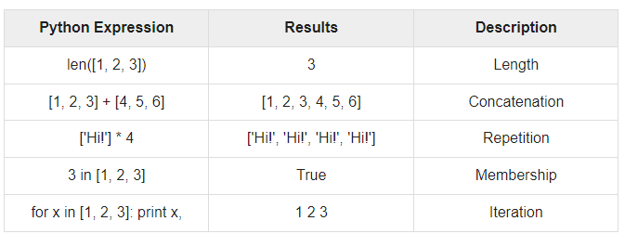
Basic List Operations:

Slide 70
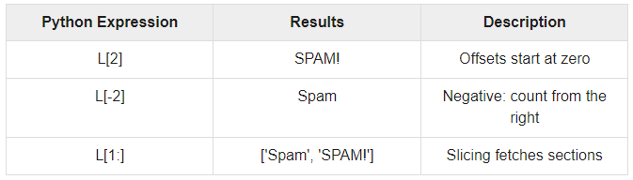
Indexing ,Slicing and Matrixes:
Lists are sequences , indexing and slicing work the same way for lists as they do for strings.
L = ['spam', 'Spam', 'SPAM!']

Slide 71
Python Tuples
A tuple is another sequence data type that is similar to the list.
A tuple consists of a number of values separated by comma.
Tuples are enclosed within parentheses.
Lists are enclosed in [] , their elements and size can be changed.
Tuples are enclosed within (()) and cannot be updated.

Slide 72
Python - Tuples
#!/usr/bin/python
tuple = ( 'abcd', 786 , 2.23, 'john', 70.2 )
tinytuple = (123, 'john')
print(tuple) # Prints the complete tuple
Print(tuple[0]) # Prints first element of the tuple
print(tuple[1:3]) # Prints elements of the tuple starting from 2nd till 3rd print tuple([2:]) # Prints elements of the tuple starting from 3rd element
print(tinytuple * 2) # Prints the contents of the tuple twice
Print(tuple + tinytuple) # Prints concatenated tuples

Slide 73
Output:
('abcd', 786, 2.23, 'john', 70.2)
abcd
(786, 2.23)
(2.23, 'john', 70.2)
(123, 'john', 123, 'john')
('abcd', 786, 2.23, 'john', 70.2, 123, 'john')

Slide 74
Python - Dictionary
Python – dictionaries work like associative arrays and consist of key – value pairs.
A dictionary key can be of any type but they are usually of the type numbers or Strings.
Values can be any arbitrary python object.
Dictionaries are enclosed by curly braces({}) .
The values can be assigned and accessed using square braces([]).

Slide 75
Dictionary - Example
#!/usr/bin/python
dict = {}
dict['one'] = "This is one"
dict[2] = "This is two"
tinydict = {'name': 'john','code':6734, 'dept': 'sales'}

Slide 76
Dictionary - Example
print(dict['one']) # Prints value for 'one' key
print(dict[2]) # Prints value for 2 key
Print(tinydict) # Prints complete dictionary
print(tinydict.keys()) # Prints all the keys
Print(tinydict.values()) # Prints all the values

Slide 77
Output:
This is one
This is two
{'dept': 'sales', 'code': 6734, 'name': 'john'}
['dept', 'code', 'name']
['sales', 6734, 'john']

Slide 78
Python – Basic Operators:
Python supports the following operators:
Arithmetic Operators
Comparison operators
Logical Operators

Slide 79
Python – Arithmetic Operators
+ Addition – Adds values on either side of the operator.
Eg, a+b = 30.
- Subtraction – Subtracts right hand operand from left hand operand.
Eg, a-b = -10
* Multiplication – Multiplies values on either side of the operator.
Eg, a*b = 200

Slide 80
Python – Comparison Operators
These operators compare the values on either sides of them and decide the relation among them.
They are also called relational operators.
Assume a = 10 and b = 20

Slide 81
Python – Comparison Operators
== : If the values of two operands are equal , then the condition becomes true.
(a==b) is not true.
!=: If the values of two operands are not equal , then the condition becomes true.
(a!=b) is true.

Slide 82
Python – Comparison Operators
>: If the value of left operand is greater than the value of right operand , then the condition becomes true.
(a>b) is not true.

Slide 83
Python – Logical Operators
a = 10, b = 20
Logical AND: If both the operands are true , then the condition becomes true.
(a and b) is true
Logical OR: If any of the two operands are non-zero , then the condition becomes true.
(a or b) is true.

Slide 84
Python – Logical Operators
Logical NOT: Used to reverse the logical state of its operand.
Not(a and b) is false.

Slide 85
Python – Decision Making
Decision making is an anticipation of conditions occuring while execution of the program.
Decision structures evaluate multiple expressions which produce TRUE or FALSE as outcome.

Slide 86
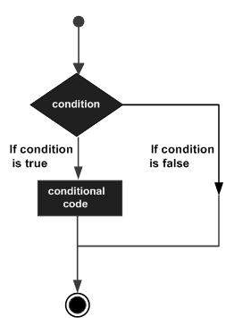
Python – Decision Making

Slide 87
Python – Decision Making
Python programming language assumes non-zero values as true and the zero values as false.
There are three different types of decision making statements:
If statements:
An if statement consists of a boolean expression followed by one or more statements.

Slide 88
Python – Decision Making
If…else statements:
An if statement can be followed by an optional else statement , which executes when the boolean expression is false.
Nested if statements:
We can use one if or else if statement inside another if or else if statements

Slide 89
Example - If
#!/usr/bin/python
var = 100
if ( var == 100 ) : print ("Value of expression is 100”)
print ("Good bye!”)

Slide 90
Output:
Value of expression is 100
Good bye!

Slide 91
Python - Loops
Statements are executed sequentially.
The first statement in a function is executed first , followed by the second and so on.
Programming languages provide various control structures that allow for more complicated execution paths.

Slide 92
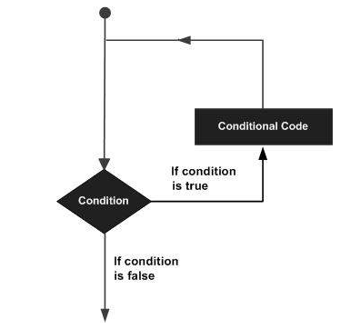
Python - Loops

Slide 93
Python - Loops
While loop:
Repeats a statement or a group of statements till the condition is true.
It tests the condition before executing the loop body.
For loop:
Executes a sequence of statements multiple times and abbreviates the code that manages the loop variable.
Nested loop:
We can use one or more loop inside any another while , for or do.. While loop.

Slide 94
Loop Control Statement:
Loop Control Statements change execution from its normal sequence.
Following are the different types of loop control statements.
Break statement:
Terminates the loop statement and transfers execution to the statement immediately following the loop.
Continue statement:
Causes the loop to skip the remainder of the body and immediately retest its condition prior to reiterating.

Slide 95
Loop Control Statement:
Pass statement:
The pass statement is used when a statement is required syntactically but we do not want any command or code to execute.

Slide 96
Python - Numbers
Number data types store numeric values.
They are immutable data types , means that changing the value of a number data type results in a newly allocated object.
Var1 = 1
Var2 = 10

Slide 97
Python - Numbers
We can also delete single object or multiple object using the del statement.
del (var)
del (var_a, var_b)

Slide 98
Python - Strings
Strings are the most popular types in python.
It can be created by enclosing characters in quotes.
Var1 = ‘Hello World’
Var2 = ‘Python Programming’

Slide 99
Python - Strings
Accessing Values in Strings:
Python does not support a character type.
They are treated as strings of length 1 , thus they are also considered a substring.
To access substrings , square brackets are used for slicing along with the index or indices to obtain the substring.

Slide 100
Python - Strings
Accessing Values in Strings:
#!/usr/bin/python
var1 = 'Hello World!'
var2 = "Python Programming"
print ("var1[0]: ", var1[0])
print ("var2[1:5]: ", var2[1:5])

Slide 101
Output:
var1[0]: H
var2[1:5]: ytho

Slide 102
Python - Strings
Updating Strings:
We can “update” an existing string by reassigning a variable to another string.
The new value can be related to the previous value or to a completely different string.
Eg:
#!/usr/bin/python
var1 = 'Hello World!'
print ("Updated String :- ", var1[:6] + 'Python’)

Slide 103
Output:
Updated String :- Hello Python

Slide 104
String Formatting Operator
One of the main features of python is the string formatting operator , %.
#!/usr/bin/python
print ("My name is %s and weight is %d kg!" % ('Zara', 21))

Slide 105
Python - Lists
A list is nothing but a list of comma separated values(items) between square brackets.
The items in a list need not be of the same data type.
list1 = ['physics', 'chemistry', 1997, 2000];
list2 = [1, 2, 3, 4, 5 ];
list3 = ["a", "b", "c", "d"]

Slide 106
Python - Lists
Accessing Values in Lists:
To access values in lists , use the square brackets for slicing along with the index or indices to obtain value at that index.
#!/usr/bin/python
list1 = ['physics', 'chemistry', 1997, 2000];
list2 = [1, 2, 3, 4, 5, 6, 7 ];
print "list1[0]: ", list1[0]
print "list2[1:5]: ", list2[1:5]

Slide 107
Output:
list1[0]: physics
list2[1:5]: [2, 3, 4, 5]

Slide 108
Python - Lists
Updating Lists:
We can update single or multiple elements of lists by giving the slice on the left – hand side of the assignment operator .
We can add to elements in the list with the append() method.

Slide 109
Python - Lists
Updating Lists:
#!/usr/bin/python
list = ['physics', 'chemistry', 1997, 2000];
print ("Value available at index 2 : “)
print (list[2])
list[2] = 2001;
print ("New value available at index 2 : " )
print (list[2])

Slide 110
Output:
Value available at index 2 :
1997
New value available at index 2 :
2001

Slide 111
Python - Lists
Delete List Elements:
To remove an element from the list , we can use either the del statement if we know exactly which elelments we are deleting or the remove method if we do not know.

Slide 112
Python - Lists
#!/usr/bin/python
list1 = ['physics', 'chemistry', 1997, 2000];
print (list1)
del (list1[2]);
print ("After deleting value at index 2 : “)
print (list)

Slide 113
Output:
['physics', 'chemistry', 1997, 2000]
After deleting value at index 2 :
['physics', 'chemistry', 2000]

Slide 114
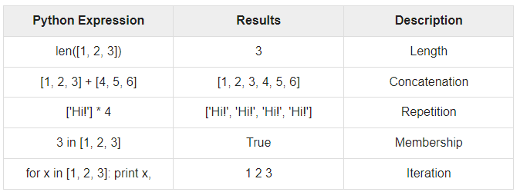
Basic List Operations:
Lists respond to the “+” and “*” operators like strings.

Slide 115
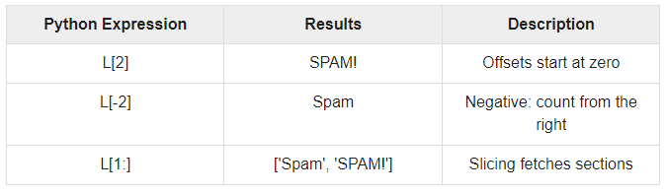
Python - Lists
Indexing , Slicing and Matrixes:
L = ['spam', 'Spam', 'SPAM!']

Slide 116
Python - Tuples
A tuple is a collection of objects which ordered and immutable.
Tuples are sequences , like lists.
The difference between lists and tuples is that tuples cannot be changed unlike lists and tuples use parentheses , whereas a list use square brackets.
tup1 = ('physics', 'chemistry', 1997, 2000);
tup2 = (1, 2, 3, 4, 5 );
up3 = "a", "b", "c", "d";

Slide 117
Python - Tuples
This is an example of empty tuple:
tup1 = ();
Accessing Values in Tuples:
To access the values in a tuple , use the square brackets for slicing along with the index to obtain the value available at that index.

Slide 118
Python - Tuples
Accessing Values in Tuples:
#!/usr/bin/python
tup1 = ('physics', 'chemistry', 1997, 2000);
tup2 = (1, 2, 3, 4, 5, 6, 7 );
print ("tup1[0]: ", tup1[0]);
print ("tup2[1:5]: ", tup2[1:5]);

Slide 119
Output:
tup1[0]: physics
tup2[1:5]: [2, 3, 4, 5]

Slide 120
Updating Tuples:
Tuples are immutable which means we cannot change or update the values of tuple elements.
#!/usr/bin/python
tup1 = (12, 34.56);
tup2 = ('abc', 'xyz');
# Following action is not valid for tuples
# tup1[0] = 100;
# So let's create a new tuple as follows
tup3 = tup1 + tup2;
print (tup3);

Slide 121
Output:
(12, 34.56, 'abc', 'xyz')

Slide 122
Delete Tuple Elements:
To explicitly remove an entire tuple , use the del statement.
#!/usr/bin/python
tup = ('physics', 'chemistry', 1997, 2000);
print tup;
del tup;
print "After deleting tup : ";
print tup;

Slide 123
Output:
('physics', 'chemistry', 1997, 2000)
After deleting tup :
Traceback (most recent call last):
File "test.py", line 9, in <module>
print tup;
NameError: name 'tup' is not defined

Slide 124
Python - Dictionary
Each key is separated from the value by a colon, the items are separated by commas and the whole thing is enclosed within curly braces.{}.
Accessing Values In Dictionary:
#!/usr/bin/python
dict = {'Name': 'Zara', 'Age': 7, 'Class': 'First'}
print ("dict['Name']: ", dict['Name'])
print ("dict['Age']: ", dict['Age'])

Slide 125
Output
dict['Name']: Zara
dict['Age']: 7

Slide 126
Updating Dictionary:
We can update a dictionary by adding a new entry or a new key-value pair.
#!/usr/bin/python
dict = {'Name': 'Zara', 'Age': 7, 'Class': 'First'}
dict['Age'] = 8; # update existing entry
dict['School'] = "DPS School"; # Add new entry
print "dict['Age']: ", dict['Age']
print "dict['School']: ", dict['School']

Slide 127
Output:
dict['Age']: 8
dict['School']: DPS School

Slide 128
Delete Dictionary Elements:
We can either remove individual dictionary elements or clear the entire contents of the dictionary.
We can also delete a entire dictionary in a single operation.

Slide 129
Delete Dictionary Elements:
#!/usr/bin/python
dict = {'Name': 'Zara', 'Age': 7, 'Class': 'First'}
del dict['Name']; # remove entry with key 'Name'
dict.clear(); # remove all entries in dict
del dict ; # delete entire dictionary
print "dict['Age']: ", dict['Age']
print "dict['School']: ", dict['School']

Slide 130
Output:
dict['Age']:
Traceback (most recent call last):
File "test.py", line 8, in <module>
print "dict['Age']: ", dict['Age'];
TypeError: 'type' object is unsubscriptable

Slide 131
Properties Of Dictionary Keys
More then one entry per key is not allowed.
No duplicate key is allowed.
When duplicate keys are encountered during assignment , the last assignment wins.
#!/usr/bin/python
dict = {'Name': 'Zara', 'Age': 7, 'Name': 'Manni'}
print "dict['Name']: ", dict['Name']

Slide 132
Output:
dict['Name']: Manni

Slide 133
Properties Of Dictionary Keys
Keys must be immutable.
It means we can use strings , numbers or tuples as dictionary keys but something like[‘key’] is not allowed.
#!/usr/bin/python
dict = {['Name']: 'Zara', 'Age': 7}
print ("dict['Name']: ", dict['Name'])

Slide 134
Output:
Traceback (most recent call last):
File "test.py", line 3, in <module>
dict = {['Name']: 'Zara', 'Age': 7};
TypeError: unhashable type: 'list'

Slide 135
Python - Functions
A function is a block of organized , reusable code that is used to perform a related action.
Functions provide better modularity and code reusability.

Slide 136
Defining a Function
Function blocks begin with the def keyword followed by the function name and parentheses(()).
Any input parameters should be placed within these parentheses.
Syntax:
def functionname( parameters ):
"function_docstring"
function_suite
return [expression]

Slide 137
Example:
def printme( str ):
"This prints a passed string into this function"
print (str)
return

Slide 138
Calling a Function
Defining a function only gives it a name, specifies the parameters that are to be included in the function and structures the blocks of code.

Slide 139
Calling a Function
#!/usr/bin/python
# Function definition is here
def printme( str ):
"This prints a passed string into this function"
print str
return;
# Now you can call printme function
printme("I'm first call to user defined function!")
printme("Again second call to the same function")

Slide 140
Output:
I'm first call to user defined function!
Again second call to the same function

Slide 141
Pass By Reference Vs Value
All the parameters in python language are passed by reference.
If you change what a parameter refers to within a function , the change also reflects back in the calling function.

Slide 142
Example:
#!/usr/bin/python
# Function definition is here
def changeme( mylist ):
"This changes a passed list into this function"
mylist.append([1,2,3,4]);
print "Values inside the function: ", mylist
return
# Now you can call changeme function
mylist = [10,20,30];
changeme( mylist );
print "Values outside the function: ", mylist

Slide 143
Output:
Values inside the function: [10, 20, 30, [1, 2, 3, 4]]
Values outside the function: [10, 20, 30, [1, 2, 3, 4]]

Slide 144
Pass By Reference (Example 2):
#!/usr/bin/python
# Function definition is here
def changeme( mylist ):
"This changes a passed list into this function"
mylist = [1,2,3,4]; # This would assig new reference in mylist
print "Values inside the function: ", mylist
return

Slide 145
Pass By Reference (Example 2):
# Now you can call changeme function
mylist = [10,20,30];
changeme( mylist );
print "Values outside the function: ", mylist

Slide 146
Output:
Values inside the function: [1, 2, 3, 4]
Values outside the function: [10, 20, 30]

Slide 147
Function Arguments
Required arguments
Keyword arguments
Default arguments
Variable – length arguments

Slide 148
Function Arguments
Required Arguments:
They are the arguments passed to a function in correct positional order.
The number of arguments in the function call should exactly match with the function definition.

Slide 149
Function Arguments
#!/usr/bin/python
# Function definition is here
def printme( str ):
"This prints a passed string into this function"
print str
return;
# Now you can call printme function
printme()

Slide 150
Output:
Traceback (most recent call last):
File "test.py", line 11, in <module>
printme();
TypeError: printme() takes exactly 1 argument (0 given)

Slide 151
Function Arguments
Keyword Arguments:
They are related to the function calls.
When we use keyword arguments in a function call , the caller identifies the arguments by the parameter name.

Slide 152
Function Arguments
Keyword Arguments:
#!/usr/bin/python
# Function definition is here
def printme( str ):
"This prints a passed string into this function"
print str
return;
# Now you can call printme function
printme( str = "My string")

Slide 153
Function Arguments
Output:
My string

Slide 154
Function Arguments
Keyword Arguments:
#!/usr/bin/python
# Function definition is here
def printinfo( name, age ):
"This prints a passed info into this function"
print "Name: ", name
print "Age ", age
return;
# Now you can call printinfo function
printinfo( age=50, name="miki" )

Slide 155
Function Arguments
Output:
Name: miki
Age 50

Slide 156
Function Arguments
Default Arguments:
A default argument is an argument that assumes a default value if the value is not provided in the function call for that argument.

Slide 157
Function Arguments
#!/usr/bin/python
# Function definition is here
def printinfo( name, age = 35 ):
"This prints a passed info into this function"
print "Name: ", name
print "Age ", age
return;
# Now you can call printinfo function
printinfo( age=50, name="miki" )
printinfo( name="miki" )

Slide 158
Output:
Name: miki
Age 50
Name: miki
Age 35

Slide 159
Variable Length Arguments
#!/usr/bin/python
# Function definition is here
def printinfo( arg1, *vartuple ):
"This prints a variable passed arguments"
print "Output is: "
print arg1
for var in vartuple:
print var
return;
# Now you can call printinfo function
printinfo( 10 )
printinfo( 70, 60, 50 )

Slide 160
Output:
Output is:
10
Output is:
70
60
50

Slide 161
The Return Statement
The statement return exits a function , optionally passing back an expression to the caller.

Slide 162
Example:
#!/usr/bin/python
# Function definition is here
def sum( arg1, arg2 ):
# Add both the parameters and return them."
total = arg1 + arg2
print "Inside the function : ", total
return total;
# Now you can call sum function
total = sum( 10, 20 );
print "Outside the function : ", total

Slide 163
Output:
Inside the function : 30
Outside the function : 30

Slide 164
Global Vs Local Variables:
Variables that are defined inside a function body have local scope and those defined outside have a global scope.
Local variables can be accessed only inside the function in which they are declared , whereas global variables can be accessed throughout the program body by all functions.

Slide 165
Example:
#!/usr/bin/python
total = 0; # This is global variable.
# Function definition is here
def sum( arg1, arg2 ):
# Add both the parameters and return them."
total = arg1 + arg2; # Here total is local variable.
print "Inside the function local total : ", total
return total;
# Now you can call sum function
sum( 10, 20 );
print "Outside the function global total : ", total

Slide 166
Output:
Inside the function local total : 30
Outside the function global total : 0

Slide 167
Follow us on:
Instagram--https://instagram.com/pantechelearning?igshid=1fohp030onteu
Telegram--https://t.me/pantechelearning
YouTube--https://youtube.com/c/PantecheLearning.
Podcasts--https://www.instagram.com/tv/COPQIigJZFi/?igshid=4gjhz4dlls1p

Slide 168
After Internship Registration what you have to do?
Login to www.pantechelearning.com
Access the Video on daily basis for next 30 Days. Practice the Concept and submit assignments
Ask your doubts in VIP Group. Group link is avail in your dashboard.
Finish all the videos and download your Certificate from your dashboard

Slide 169
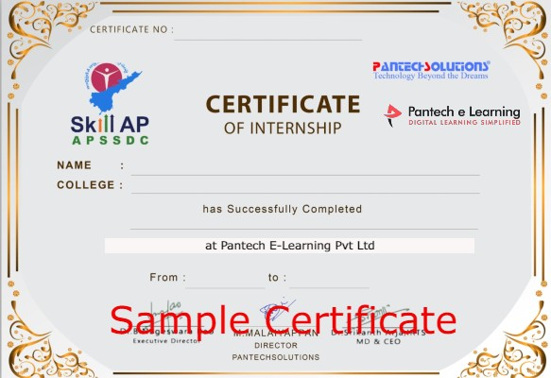
Internship Certificate (Sample)

Slide 170
Projects Included in Internship.
Pantech will make you to Create 10 Projects in Data Science Engineering in 30 Days

Slide 171
Happy learning
30 Days Internship on Machine Learning Master Class
Reg Link: https://imjo.in/Rb6xqe
Discount Coupon Code: WELCOMEML
Call / whatsapp : +91 9840974408

Slide 172
THANKS
Further Information:
Senthil Kumar – 98409 74406
Srinivasan – 7010888841
Kumarasamy - 8925533489
www.pantechelearning.com | training@pantechmail.com

Slide 173


